Slide 1
Today’s Trends
Basic 10 Unit 4a

Slide 2
Expressions to agree | Expressions to disagree
I agree (with you) That’s true. That’s right. Definitely / Absolutely. I feel the same way. I couldn’t agree with you more. | Politely Disagree: I know what you´re saying, but… Sorry, but I disagree. I hear you, but …(inf)
 | Strongly Disagree: That´s not true I totally/completely disagree Oh, come on! Are you serious? (inf)

Slide 3
Expressions to disagree
Politely Disagree: I know what you´re saying, but… Sorry, but I disagree. I hear you, but…(inf) | Strongly Disagree: That´s not true I totally/completely disagree Oh, come on! Are you serious? (inf)
Expressions to agree
I agree (with you) That’s true. That’s right. | Definitely / Absolutely. I feel the same way. I couldn’t agree with you more.

Slide 4
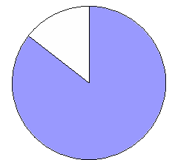
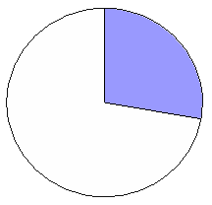
14-3 EXPRESSIONS OF QUANTITY: ALL OF, MOST OF,
SOME OF, ALMOST ALL OF
(a) Darren likes all of his classes.
(b) Alex likes most of his classes.
(c) Jung-Min likes some of her classes.
all of
most of
some of

Slide 5
14-3 Let’s Practice
all of
most of
some of
Some of
_______ these shapes are hearts.

Slide 6
14-3 Let’s Practice
all of
most of
some of
______ these shapes are green.
Most of

Slide 7
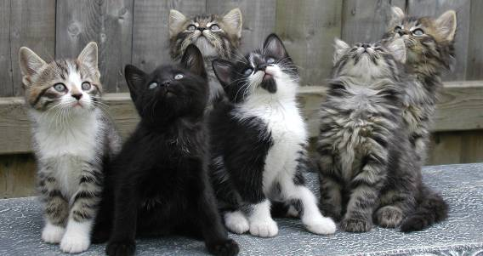
14-3 Let’s Practice
all of
most of
some of
__________ the kittens
are looking up.
Most of

Slide 8
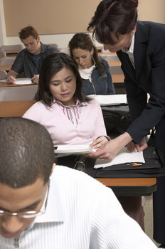
14-4 EXPRESSIONS OF QUANTITY: SUBJECT-VERB
AGREEMENT
All of your homework is correct.

Slide 9
14-4 EXPRESSIONS OF QUANTITY: SUBJECT-VERB
AGREEMENT
(a) All of your homework is correct.
all of + singular noun + singular verb

Slide 10
14-4 EXPRESSIONS OF QUANTITY: SUBJECT-VERB
AGREEMENT
(b) All of those dogs are friendly.
all of + plural noun + plural verb

Slide 11
14-4 EXPRESSIONS OF QUANTITY: SUBJECT-VERB
AGREEMENT
(c) Some of the food is spicy.
some of + singular noun + singular verb

Slide 12
14-4 EXPRESSIONS OF QUANTITY: SUBJECT-VERB
AGREEMENT
(d) Some of my dogs are old.
some of + plural noun + plural verb

Slide 13
14-4 EXPRESSIONS OF QUANTITY: SUBJECT-VERB
AGREEMENT
(a) All of your homework is correct.
(b) All of those dogs are friendly.
(c) Some of the food is messy.
(d) Some of my dogs are old.
COMMON EXPRESSIONS OF QUANITITY
all of most of a lot of
some of a couple of none of

Slide 14
14-5 EXPRESSIONS OF QUANTITY: ONE OF, NONE OF
(d) None of our classmates were sick.
none of = not one of

Slide 15
14-5 Let’s Practice
was
were
None of my friends ____ here last week.
were

Slide 16
Quantity Expressions
Most of the families are unmarried and living together.
Some of the families are married.

Slide 17
Quantity Expressions
A lot of families use bicycles.
Some of the families use cars

Slide 18
Quantity Expressions
Most of the families are unmarried and living together
(from a group)
Most families are unmarried and living together.
(of all the families everywhere)
Most students work hard.
Most of the students in our class work hard.

